Slide 1

EE 4345 – Semiconductor Electronics
Design Project
RESISTORS
Anuj Shah
Himanshu Doshi
Jayaprakash Chintamaneni
Nareen Katta
Nikhil Patel
Preeti Yadav

Slide 2
OVERVIEW
  RESISTANCE
  MEASUREMENT TECHNIQUES
  RESISTOR LAYOUT
  PROCESS VARIATION
  RESISTOR PARASITICS

Slide 3
TYPES OF MATERIALS
CONDUCTORS
SEMICONDUCTORS
INSULATORS
DEFINITION OF RESISTANCE
THE ABILITY WITH WHICH CURRENT FLOW IS ESTABLISHED AND MAINTAINED IS A METHOD OF CLASSIFYING MATERIALS AND IS COMMONLY REFERRED TO AS THE RESISTANCE OF THE MATERIAL.

Slide 4
SYMBOL - R
UNITS - OHM (Ω)
ELECTRICAL -
REPRESENTATION
MATHEMATICAL - R = (ρ * L) / A
REPRESENTATION

Slide 5
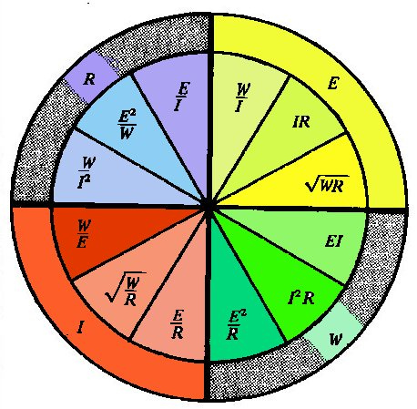
THE WHEEL SHOWS DC RELATIONSHIPS IN OHMS LAW
R = RESISTANCE
E = VOLTAGE
I = CURRENT
W = POWER

Slide 6
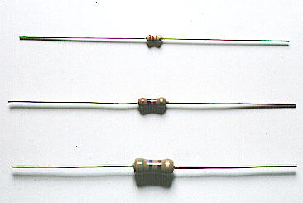
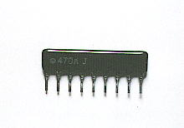
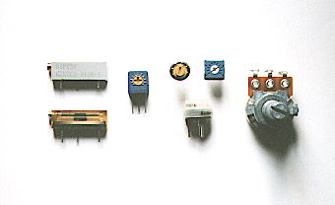
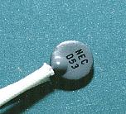
TYPES OF RESISTORS
SINGLE IN LINE RESISTOR
NETWORK (SIL)
CARBON FILM RESISTOR
VARIABLE RESISTORS
THERMISTORS

Slide 7
RESISTOR COLOR CODES
    BLACK=0 GREEN = 5
    BROWN=1 BLUE = 6
    RED = 2 VIOLET = 7
    ORANGE = 3 GREY = 8
    YELLOW = 4 WHITE = 9
    GOLD = 5 % SILVER = 10%
BAD BOOZE ROTS OUR YOUNG GUTS BUT VODKA GOES WELL !!

Slide 8
SHEET RESISTANCE (R_{s})
R = ρ * L / (w * t)
R = R_{s} * L/w R_{s} = ρ / t
Units – Ohms per square (Ω / )
w
t
L

Slide 9
EXAMPLE
CONTACT 1
CONTACT 2
1 2 3 4 5
W
L
L / W = 5 R_{s} = 50 Ω /
R = R_{s} * L / W
R = 250 Ω

Slide 10
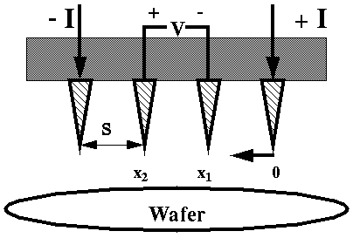
SHEET RESISTANCE MEASUREMENT
FOUR POINT PROBE
R_{s} = K * V / I
WHERE K = GEOMETRIC FACTOR

Slide 11
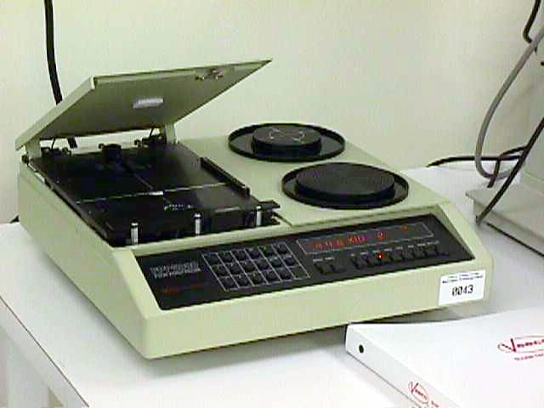
4 - POINT
PROBE
MODEL
FPP - 5000
DIRECT CALCULATION OF V / I
SHEET RESISTIVITY
METALLIZATION THICKNESS
P-N TYPE TESTING

Slide 12
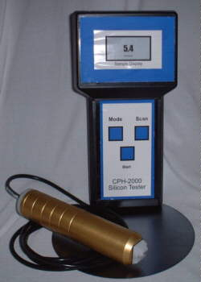
CPH - 2000
4 POINT PROBE
PORTABLE
P/N TYPE SOUND
REPORTING
COMPUTERIZED
ACCURACY

Slide 13
WIDTH BIAS MODEL
W_{d}
W_{b}
L_{d}
R = R_{S}* [L_{d} / (W_{d} + W_{b})]
W_{e} = W_{d} + W_{b}

Slide 14
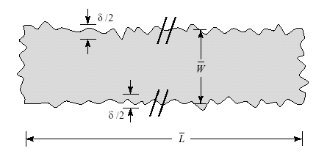
LINEWIDTH UNCERTAINTIES
Due to lithographic and etching variation, the edges of a rectangle are “ragged”
W = W (+/-) δ

Slide 15
NON UNIFORM CURRENT FLOW
ΔR = (R_{s} / π) *[(1/k)*ln(k+1/(k-1))+ln((k²-1)/k²)]
where k = W_{e} / (W_{e} - W_{c})
ΔR represents the increase in resistance

Slide 16
SERPENTINE RESISTORS
A
C
B
D
R = Rs(2A+B/W + 1.12)
R = R_{s}(2C/W + 2.96)

Slide 17
DOGBONE RESISTORS
W_{c}
W_{d}
L_{d}
W₀
W₀ W_{c} ΔR
W_{d} W_{d} -0.7
0.5 W_{d} W_{d} -0.3

Slide 18
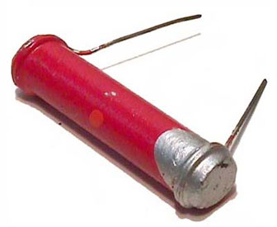
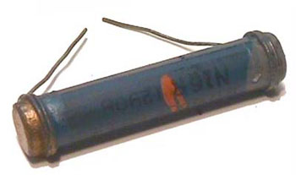
RES-DBBNE-22/4
RES-DBBNE-100/4

Slide 19
PACKING DENSITY
DOGBONE
SERPENTINE

Slide 20


Slide 21
RESISTOR VARIABILITY
THE VALUE OF A RESISTOR DEPENDS MAINLY ON THE FOLLOWING FACTORS :
PROCESS VARIABILITY
TEMPERATURE
NON-LINEARITY
CONTACT RESISTANCE

Slide 22
PROCESS VARIATION
R = R_{S} * L/W
where
R_{S} – SHEET RESISTANCE
FACTORS EFFECTING SHEET RESISTANCE
FLUCTUATION IN FILM THICKNESS
DOPING CONCENTRATION
DIMENSIONS OF RESISTOR VARY BECAUSE OF PHOTOLITHOGRAPHIC INACCURACIES

Slide 23
ACTUAL TOLERANCE FOR A RESISTOR
δR = (C_{L} / W_{E}) + δR_{S}
where
δR – TOLERANCE OF THE RESISTOR
C_{L} – LINEWIDTH CONTROL OF THE APPLICABLE LAYER
δR_{S} – VARIABILITY OF THE SHEET RESISTANCE

Slide 24
DESIGN GUIDELINES
WHERE TOLERANCE DOES NOT MATTER, USE MINIMUM WIDTH RESISTORS AND EXPECT VARIATIONS OF ABOUT + 50%
WHERE MODERATELY PRECISE TOLERANCE IS REQUIRED, USE RESISTORS 2 TO 3 TIMES AS WIDE AS THE FEATURE SIZE AND EXPECT VARIATIONS OF + 35%
WHERE MAXIMUM PRECISE TOLERANCE IS REQUIRED, USE RESISTORS 5 TIMES AS WIDE AS THE FEATURED SIZE AND EXPECT VARIATIONS OF + 30%

Slide 25
TEMPERATURE VARIATION
RESISTIVITY DEPENDS ON TEMPERATURE IN A NON-LINEAR MANNER
R(T)= R(To)[1+10⁻⁶TC₁(T-To)]
R(T)- RESISTANCE AT THE DESIRED TEMPERATURE
R(To)- RESISTANCE AT , ANOTHER TEMPERATURE, To
TC₁- LINEAR TEMPERATURE CO-EFFICIENT OF RESISTIVITY IN PPM/^{O}C

Slide 26
TYPICAL LINEAR TEMPERATURE COEFFICIENTS OF RESISTIVITY FOR SELECTED MATERIALS AT 25°C
MATERIAL | TCR PPM/°C
ALUMINUM | +3800
COPPER,BULK | +4000
GOLD,BULK | +3700
160Ω/ BASE DIFFUSION | +1500
7Ω/ EMMITER DIFFUSION | + 600
5KΩ/ BASE PINCH DIFFUSION | +2500
2KΩ/ HSR IMPLANT (P-TYPE) | +3000
500Ω/ POLYSILICON (4KÅ N-TYPE) | - 1000
25Ω/ POLYSILICON (4KÅ N-TYPE) | +1000
10KΩ/ N-WELL | +6000

Slide 27
NON-LINEARITY
FACTORS EFFECTING NONLINEARITY :
SELF HEATING
HIGH-FIELD VELOCITY SATURATION
DEPLETION REGION ENCROACHMENT

Slide 28
TEMPERATURE RISE BETWEEN THE RESISTOR AND THE SILICON SUBSTRATE IS GIVEN BY THE FOLLOWING EXPRESSION :
ΔT = 71* V²*T_{OX}/(R_{S}*L)
where
R_{S} – SHEET RESISTANCE OF THE POLY IN Ω/
T_{OX} – THICKNESS OF THE FIELD OXIDE IN ANGSTROMS (Å)
L - LENGTH OF THE RESISTOR IN MICRONS
V - VOLTAGE APPLIED ACROSS THE RESISTOR

Slide 29
THE MINIMUM RESISTOR LENGTH TO MINIMIZE NON-LINEARITY EQUALS
LMIN = (6.7 μM/V) * VMAX FOR N-TYPE SILICON
LMIN = (3.3 μM/V) * VMAX FOR P-TYPE SILICON
where
VMAX – MAXIMUM VOLTAGE APPLIED ACROSS THE RESISTOR

Slide 30
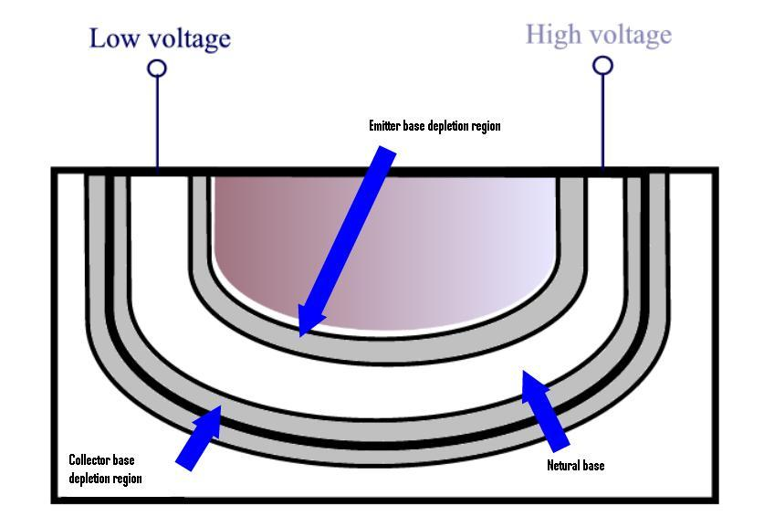
CROSS SECTION OF A BASE PINCH RESISTOR

Slide 31
TANK MODULATION
DEPLETION REGIONS CAUSE AN INCREASE IN RESISTANCE WHEN SIGNIFICANT TANK BIAS IS APPLIED.
AS THE VOLTAGE DIFFERENCE BETWEEN THE RESISTOR AND THE TANK INCREASES, THE DEPLETION REGIONS WIDEN AND THE RESISTANCE INCREASES. THIS EFFECT IS CALLED TANK MODULATION.

Slide 32
CONDUCTIVITY MODULATION
CONDUCTIVITY MODULATION OCCURS WHEN THE ELECTRIC FIELDS GENERATED BY THE LEADS THAT CROSS A LIGHTLY DOPED RESISTOR CAUSE CARRIERS TO REDISTRIBUTE IN THE BODY OF THE RESISTOR.

Slide 33
CONTACT RESISTANCE
THE RESISTANCE RC ADDED BY A SINGLE CONTACT HAVING WIDTH W_{C} AND LENGTH L_{C} EQUALS
R_{C} = (R_{S}*ρ_{C})^{1/2} COTH(L_{C} *(R_{S}/ ρ_{C})^{1/2})/W_{C}
R_{S} – SHEET RESISTANCE OF THE RESISTOR MATERIAL
ρ_{C} – SPECIFIC CONTACT RESISTANCE
COTH( ) – IT REPRESENTS THE HYBERBOLIC COTANGENT FUNCTION

Slide 35
RESISTOR PARASITICS
CAPACITIVE AND INDUCTIVE COUPLING AT HIGH FREQUENCIES
JUNCTION LEAKAGE

Slide 36
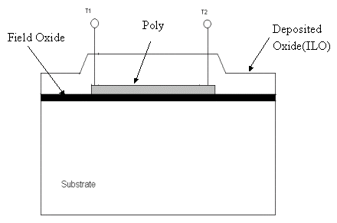
POLYSILICON RESISTOR
CROSS SECTION OF POLYSILICON RESISTOR

Slide 37
CHARACTERISTICS OF OXIDE LAYER
INSULATOR PREVENTING LEAKAGE
CAPACITIVE DIELECTRIC THAT COUPLES THE RESISTOR TO ADJOINING COMPONENTS

Slide 38
FIELD OXIDE LAYER
CAPACITANCE DUE TO FIELD OXIDE = 0.05 f F/μM²
CONSIDERING A RESISTOR OF 5 μ M WIDE AND CONTAINS 100 SQUARES,
TOTAL SUBSTRATE CAPACITANCE = 0.125 pF

Slide 39
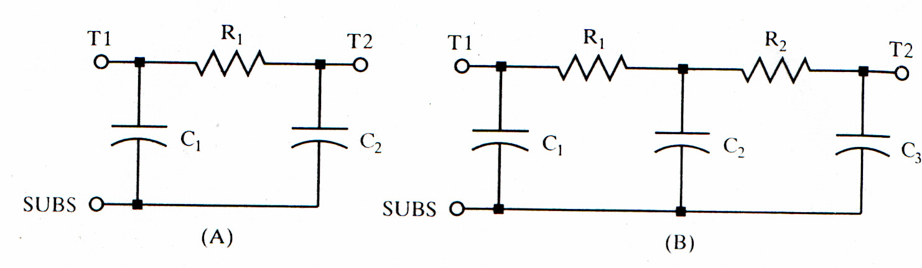
SUBCIRCUIT MODEL (π-SECTION)
FOR TOTAL SUBSTRATE CAPACITANCE = C ,
IN FIG(A) C₁ = C₂ = C/2
IN FIG(B) C₁ = C₃ = C/4 ;
C₂ = C/2

Slide 40
INTERLEVEL OXIDE (ILO)
CAPACITANCE DUE TO ILO = 0.5 f F/μM²
CONSIDERING A 3 μM LEAD CROSSING A 5 μM–WIDE RESISTOR
COUPLING CAPACITANCE = 7.5 f F

Slide 41
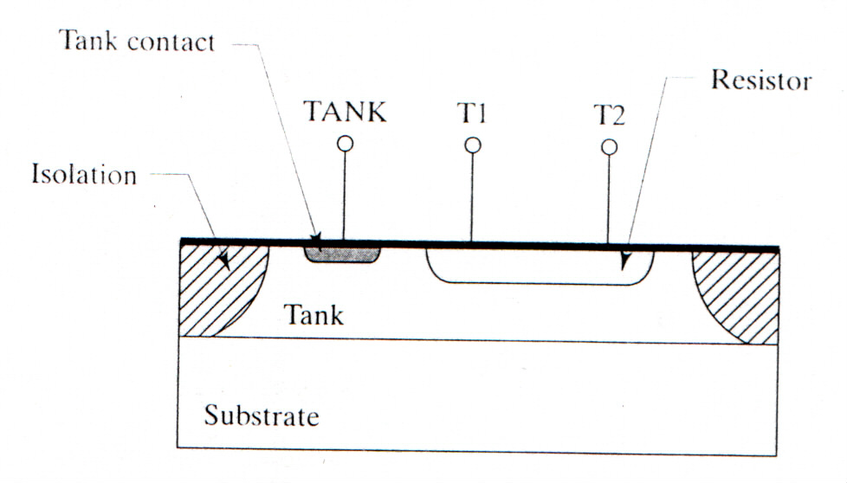
DIFFUSED RESISTOR
CROSS SECTION OF DIFFUSED RESISTOR

Slide 42
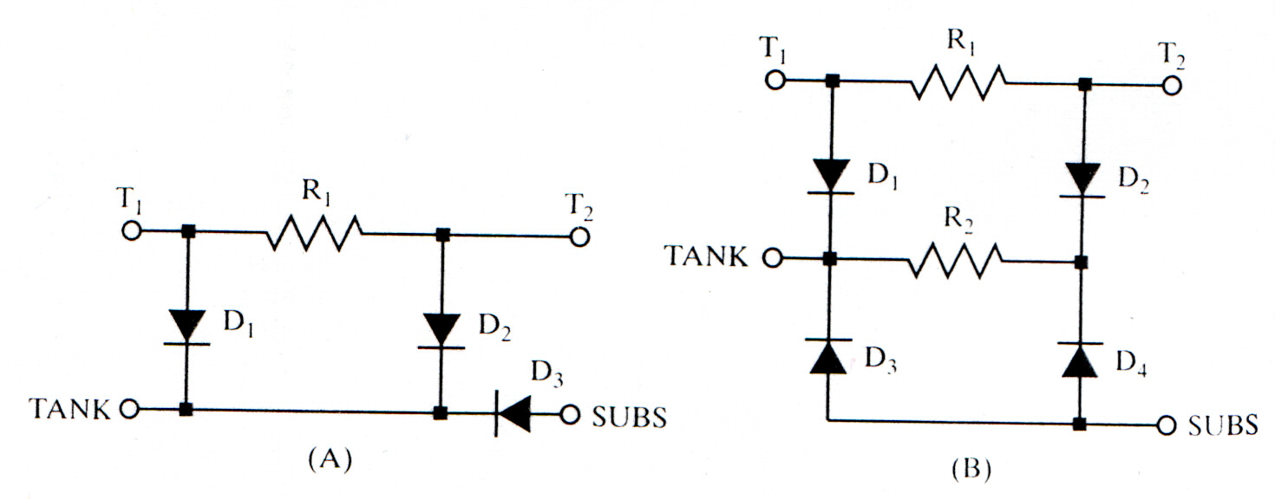

SUBCIRCUIT MODEL (π-SECTION)
IN FIGURE (A) FOR LOW TANK RESISTANCE:
  D₁ & D₂ = HALF OF THE TOTAL AREA OF RESISTOR-TANK JUNCTION
  D₃ = FULL AREA OF TANK-SUBSTRATE JUNCTION
IN FIGURE (B) FOR HIGH TANK RESISTANCE:
  R₂ = TANK RESISTANCE
  D₃ & D₄ = HALF OF THE TOTAL AREA OF TANK SUBSTRATE JUNCTION

Slide 43
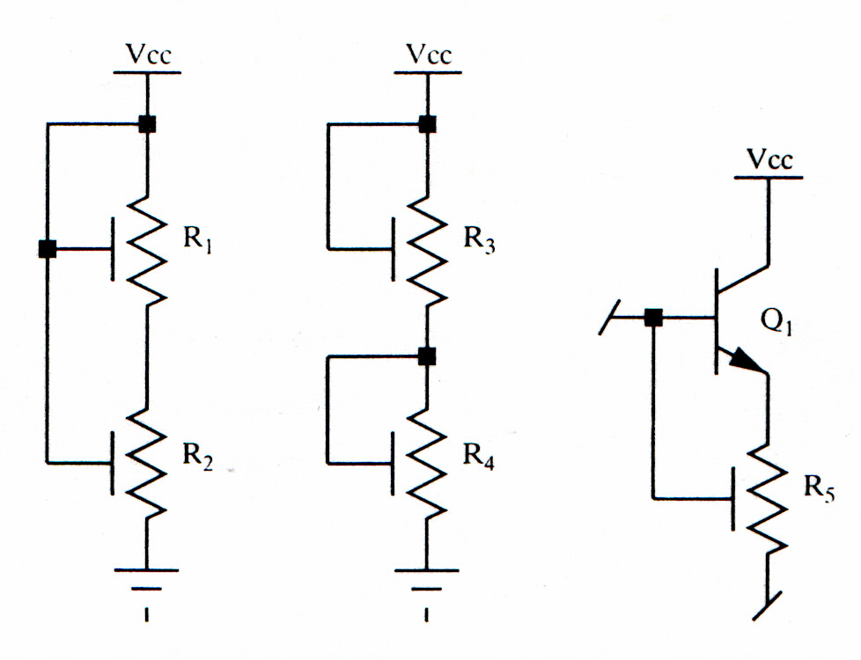
TANK BIASING SCHEMES

Slide 44
THE AVALANCHE BREAKDOWN IN THE REVERSE-BIASED JUNCTIONS OCCURS WHEN THE BIAS ACROSS A RESISTOR EXCEEDS ITS BREAKDOWN VOLTAGE. THIS CAN BE OVERCOME BY CONSTRUCTING MULTIPLE SEGMENTS IN SEPARATE TANKS.
EXAMPLE: 7V FOR EMITTER RESISTOR AND BASE PINCH RESISTORS.
THE DEPLETION REGIONS ASSOCIATED WITH THE REVERSE-BIASED JUNCTIONS HAVE CONSIDERABLE CAPACITANCE DEPENDING ON THE DOPING AND THE REVERSE BIAS.
EXAMPLE: TYPICALLY 1 TO 5 f F/μM²

Slide 45
REFERENCES
THE ART OF ANALOG LAYOUT BY ALAN HASTINGS
RESISTANCE AND RESISTORS BY CHARLES WELLARD

